Slide 1

ONLINE AUCTION SYSTEM USING ADVANCED DATA STRUCTURES
Presented By:
1.Shaik Maheer
2. Nanjala Vikram Karthikeya
Course:
B.Tech in Computing and Data science
Institution: Sai University
Technologies Used:
C Programming, Data Structures

Slide 2
Problem Statement:
Module-Based Problem Statements
1.Player Management
Develop a system to register and store auction participants dynamically using linked lists.
2.Item Management
Create a mechanism to add, store, and display auction items efficiently.
3.Bid Management
Implement a Max Heap to manage bids and retrieve the highest bid in optimal time.
3.Bid Dependency Management
Use a Directed Acyclic Graph (DAG) to represent dependencies among bids and prevent cycles.
4.Validation and Security
Ensure only registered players can place bids and that dependencies remain logically consistent.
5.Data Persistence
Store auction details in a file for future reference and analysis.
6.System Reporting
Provide comprehensive displays of players, items, highest bids, and dependency graphs.

Slide 3
Real-World Applications
1.E-Commerce Platforms
Used in online marketplaces such as eBay and Amazon Auctions to sell products to the highest bidder.
2.Government Tender and Procurement Systems
Organizations invite companies to bid for contracts, ensuring fair and transparent selection.
3.IPL and Sports Player Auctions
Teams bid for players in leagues like the Indian Premier League (IPL).
4.Real Estate and Property Bidding Systems
Properties and land are auctioned to buyers offering the highest price.
Benefits of the System
Automation and Accuracy
Reduces manual work and minimizes human errors.
Transparency in Bidding
Ensures fairness and builds trust among participants.
Efficient Decision-Making
Quickly identifies the highest bid using optimized data structures

Slide 4
Data Structures Used :
Data Structure | Purpose
Linked List | Stores players and items dynamically
Max Heap | Determines the highest bid efficiently
Directed Acyclic Graph (DAG) | Manages bid dependencies
Adjacency Matrix | Represents relationships between bids
Arrays | Stores bids and graph data

Slide 5
System Design :
Modules of the System:
1.Player Management
2.Item Management
3.Bid Management
4.Dependency Management
5.File Handling
Workflow:
1.Register players.
2.Add items for auction.
3.Place bids on items.
4.Track highest bid using a Max Heap.
5.Manage bid dependencies using a DAG

Slide 6
Algorithm :
Max Heap Insertion Algorithm
1.Insert the bid at the end of the heap.
2.Compare with the parent node.
3.Swap if the bid amount is greater.
4.Repeat until heap property is satisfied.
Cycle Detection in DAG
1.Use Depth First Search (DFS).
2.Track visited nodes and recursion stack.
3.If a node is revisited in the stack, a cycle exists.
4.Reject the dependency to maintain acyclicity.

Slide 7
Implementation :
Programming Language: C
Follows modular programming principles.
Menu-driven interface for user interaction.
File handling used to store auction data.
Key Functionalities:
Add Players
Add Items
Place Bids
Show Highest Bid
Display Bid Dependency DAG
Save Data to File

Slide 8
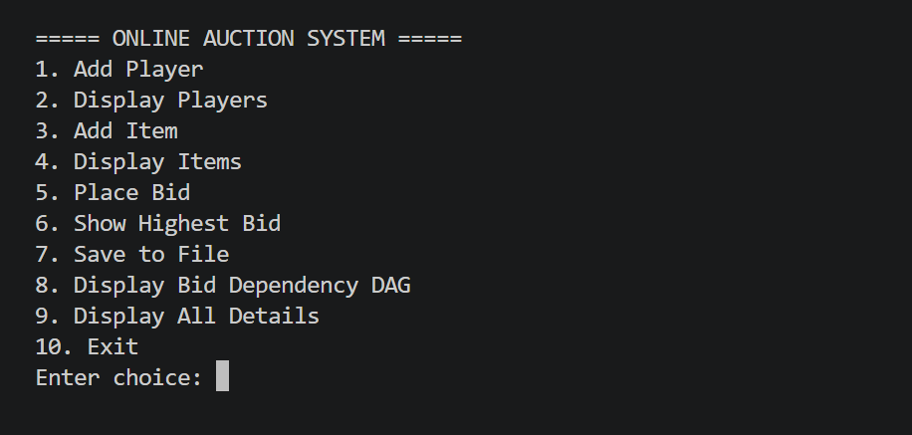
Demo Output:
Sample Menu Output:

Slide 9

Online Auction Platform QR code

Slide 10


